Slide 1

AAGAZ 2022
Bal Bharati Public School, Khargone
Wednesday, 3rd May 2023
COMPETITION | PARTICIPANT | CLASS / SECTION | NO. OF PARTICIPATING SCHOOLS | POSITION
Toddler Models (Ramp Walk) | NIMISH PANT JASNOOR ARORA | PRE PRIMARY D PRE PRIMARY B | 10 | I

Slide 2
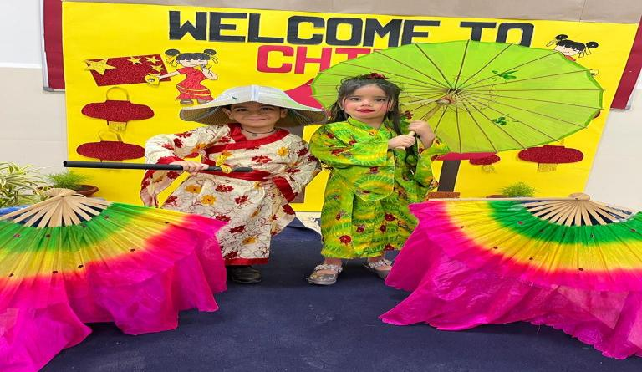
AAGAZ 2022
Bal Bharati Public School, Khargone
Wednesday, 3rd May 2023

Slide 3
AAGAZ 2022
Bal Bharati Public School, Khargone
Wednesday, 3rd May 2023
COMPETITION | PARTICIPANT | CLASS / SECTION | NO. OF PARTICIPATING SCHOOLS | POSITION
TAPPING TOES | ANAISHA JAIN PRESHAA JAIN | PRE PRIMARY E | 9 | I

Slide 4
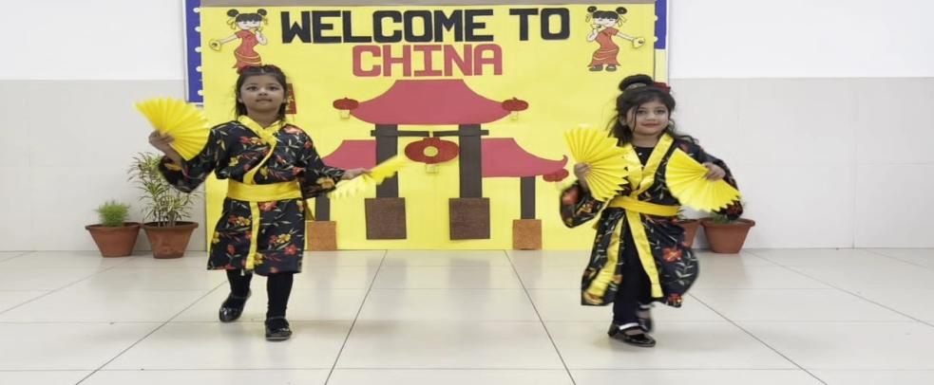
AAGAZ 2022
Bal Bharati Public School, Khargone
Wednesday, 3rd May 2023

Slide 5
DEEP JYOTI - 2023
DEEP MEMORIAL PUBLIC SCHOOL, RAMPRASTHA, GHAZIABAD
MONDAY, 31st JULY 2023
COMPETITION | PARTICIPANT | CLASS / SECTION | NO. OF PARTICIPATING SCHOOLS | POSITION
RAGS TO RICHES (DRESS OUT OF WASTE COMPETITION) | ANVIKA GUPTA MS. BHAWNA SHARMA | PRE PRIMARY F FACILITATOR | 13 | I

Slide 6
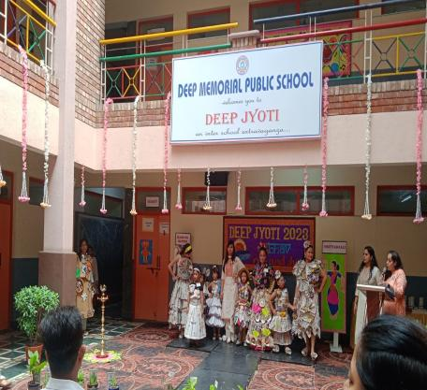
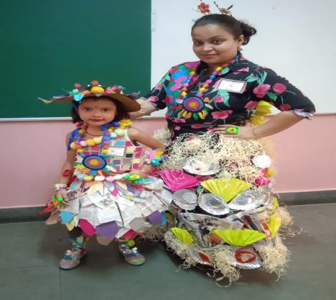
DEEP JYOTI - 2023
DEEP MEMORIAL PUBLIC SCHOOL, RAMPRASTHA, GHAZIABAD
MONDAY, 31st JULY 2023

Slide 7
SPECTRUM-2023
VISHWA BHARATI PUBLIC SCHOOL, CROSSING REPUBLIC, GHAZIABAD
FRIDAY, 18th AUGUST 2023
COMPETITION | PARTICIPANT | CLASS / SECTION | NO. OF PARTICIPATING SCHOOLS | POSITION
THE PATRIOTS (ENGLISH POEM RECITATION ON INDIA) | KUNJIKA JAIN | PRE SCHOOL C | 11 | II

Slide 8
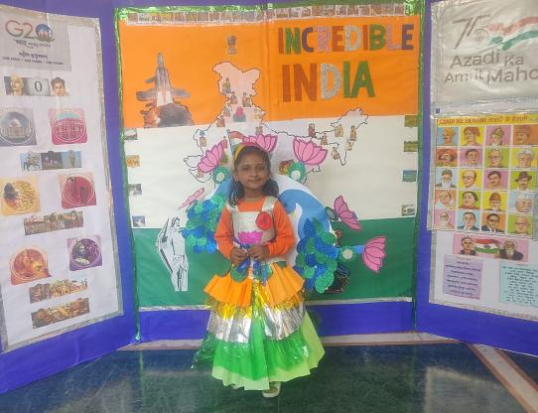
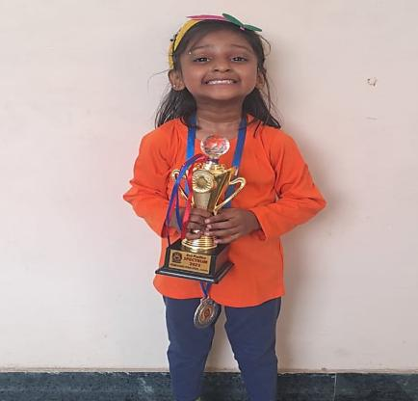
SPECTRUM-2023
VISHWA BHARATI PUBLIC SCHOOL, CROSSING REPUBLIC, GHAZIABAD
FRIDAY, 18th AUGUST 2023

Slide 9
SPECTRUM-2023
VISHWA BHARATI PUBLIC SCHOOL, CROSSING REPUBLIC, GHAZIABAD
FRIDAY, 18th AUGUST 2023
COMPETITION | PARTICIPANT | CLASS / SECTION | NO. OF PARTICIPATING SCHOOLS | POSITION
RAISE YOU MIC (TALE OF INDIAN FREEDOM FIGHTER) | AVIR CHOPRA | II A | 11 | II

Slide 10
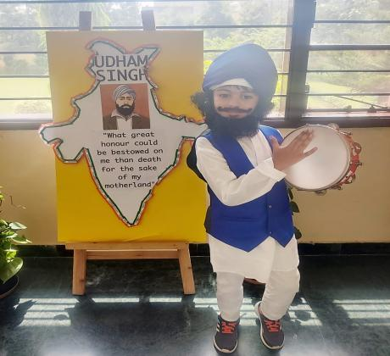
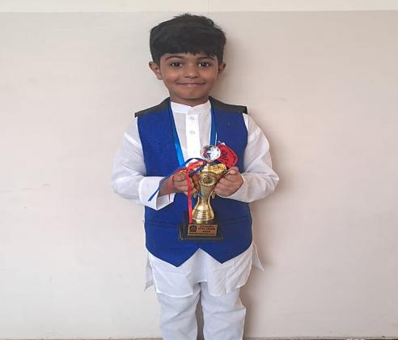
SPECTRUM-2023
VISHWA BHARATI PUBLIC SCHOOL, CROSSING REPUBLIC, GHAZIABAD
FRIDAY, 18th AUGUST 2023

Slide 11
RAZZLE DAZZLE 2023-24
K.D.B PUBLIC SCHOOL, OLD KAVI NAGAR, GHAZIABAD
SATURDAY, 26th AUGUST 2023
COMPETITION | PARTICIPANT | CLASS / SECTION | NO. OF PARTICIPATING SCHOOLS | POSITION
SAVIOURS (FANCY DRESS) | ATHARV NATANI | PRE SCHOOL C | 15 | I

Slide 12
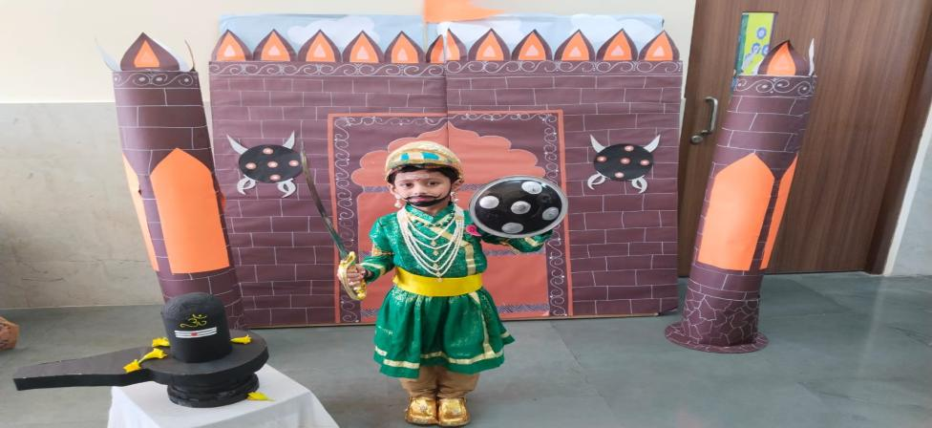
RAZZLE DAZZLE 2023-24
K.D.B PUBLIC SCHOOL, OLD KAVI NAGAR, GHAZIABAD
SATURDAY, 26th AUGUST 2023

Slide 13
RAZZLE DAZZLE 2023-24
K.D.B PUBLIC SCHOOL, OLD KAVI NAGAR, GHAZIABAD
SATURDAY, 26th AUGUST 2023
COMPETITION | PARTICIPANT | CLASS / SECTION | NO. OF PARTICIPATING SCHOOLS | POSITION
DANCING LITTLE CHAMPS (FOLK DANCE) | ROSHIKA BAISOYA AANYA GOLA | II E II C | 20 | CONSOLATION

Slide 14
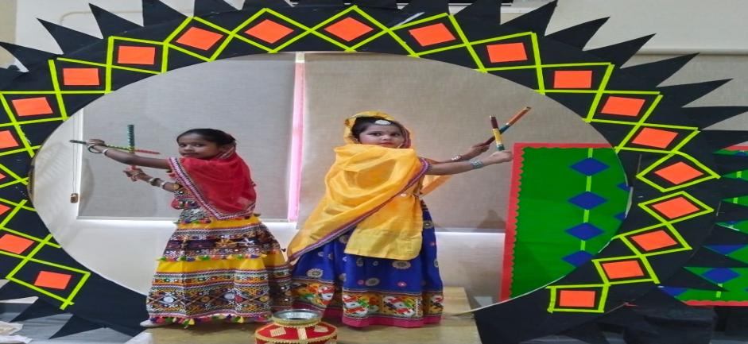
RAZZLE DAZZLE 2023-24
K.D.B PUBLIC SCHOOL, OLD KAVI NAGAR, GHAZIABAD
SATURDAY, 26th AUGUST 2023

Slide 15
INVICTUS 3.0 2023
D.A.V. CENTENARY PUBLIC SCHOOL, CHANDER NAGAR, GHAZIABAD
THURSDAY, 14th SEPTEMBER 2023
COMPETITION | PARTICIPANT | CLASS / SECTION | POSITION
LET'S SALUTE | ANAYA | Pre School G | II

Slide 16
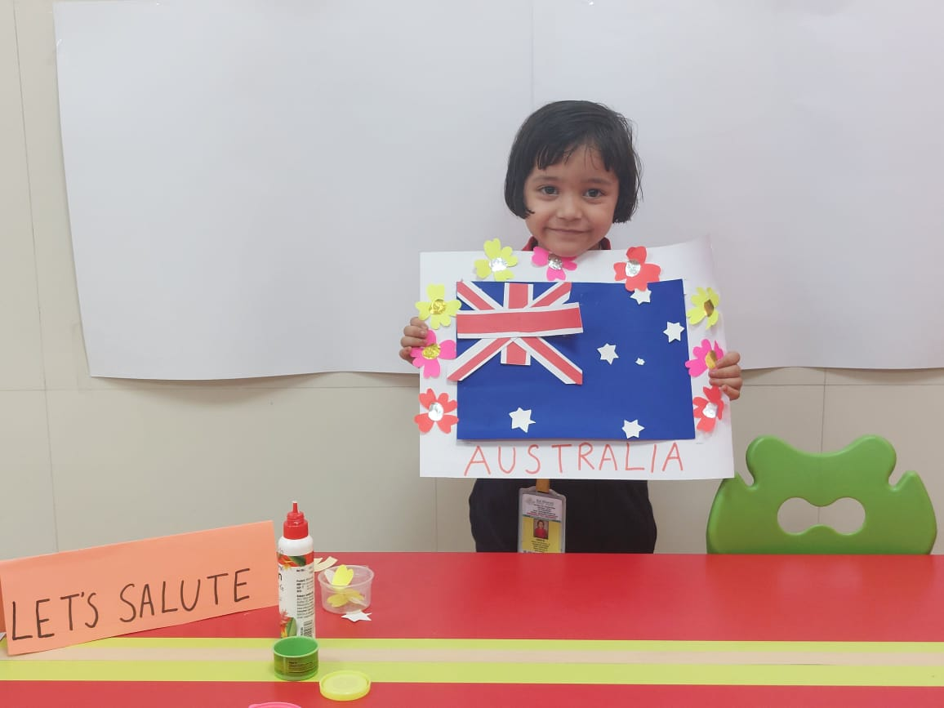
INVICTUS 3.0 2023
D.A.V. CENTENARY PUBLIC SCHOOL, CHANDER NAGAR, GHAZIABAD
THURSDAY, 17th SEPTEMBER 2023

Slide 17
INVICTUS 3.0 2023
D.A.V. CENTENARY PUBLIC SCHOOL, CHANDER NAGAR, GHAZIABAD
THURSDAY, 14th SEPTEMBER 2023
COMPETITION | PARTICIPANT | CLASS / SECTION | POSITION
LET'S GET READY | SARTHAK KUMAR | Pre Primary G | II

Slide 18
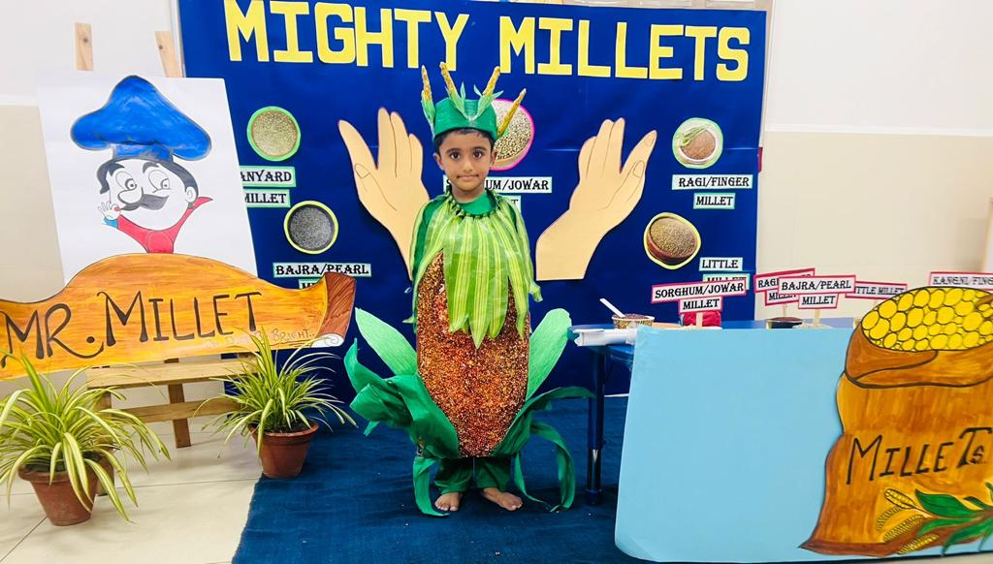
INVICTUS 3.0 2023
D.A.V. CENTENARY PUBLIC SCHOOL, CHANDER NAGAR, GHAZIABAD
THURSDAY, 17th SEPTEMBER 2023

Slide 19
INVICTUS 3.0 2023
D.A.V. CENTENARY PUBLIC SCHOOL, CHANDER NAGAR, GHAZIABAD
THURSDAY, 14th SEPTEMBER 2023
COMPETITION | PARTICIPANT | CLASS / SECTION | POSITION
POSHAAK | AVIKA GOVIL AARNA AGARWAL | I F II E | III

Slide 20
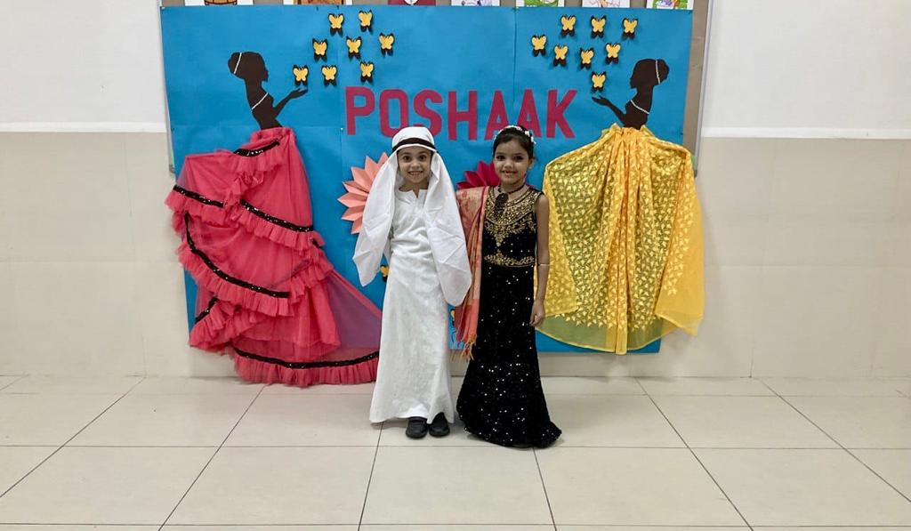
INVICTUS 3.0 2023
D.A.V. CENTENARY PUBLIC SCHOOL, CHANDER NAGAR, GHAZIABAD
THURSDAY, 17th SEPTEMBER 2023

Slide 21
SPONTANIA 2023
DELHI PUBLIC SCHOOL GHAZIABAD, INTERNATIONAL
THURSDAY, 12th OCTOBER 2023
COMPETITION | PARTICIPANT | CLASS / SECTION | NO. OF PARTICIPATING SCHOOLS | POSITION
HAPPY FEET (Group Dance Competition) | AASHVI GUPTA AANYA GOLA ROSHIKA BAISOYA SHIVYA JINDAL | II B II C II E II E | 16 | I

Slide 22
SPECTRUM 2.0
ALLENHOUSE PUBLIC SCHOOL, GHAZIABAD
THURSDAY & FRIDAY, 18th – 19th OCTOBER 2023
COMPETITION | PARTICIPANT | CLASS / SECTION | NO. OF PARTICIPATING SCHOOLS | POSITION
TAP YOUR FEET (Duet Dance) | SIDDHI VATS AARNA AGRAWAL | II A II E | 25 | I

Slide 23
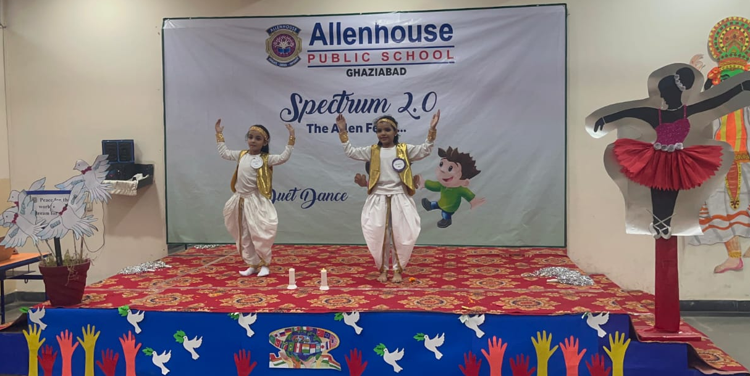
SPECTRUM 2.0
ALLENHOUSE PUBLIC SCHOOL, GHAZIABAD
THURSDAY & FRIDAY, 18th – 19th OCTOBER 2023

Slide 24
SPECTRUM 2.0
ALLENHOUSE PUBLIC SCHOOL, GHAZIABAD
THURSDAY & FRIDAY, 18th – 19th OCTOBER 2023
COMPETITION | PARTICIPANT | CLASS / SECTION | NO. OF PARTICIPATING SCHOOLS | POSITION
FASHION SHOW (Feel Good Fashion) | JANHVI JAIN | Pre Primary F | 25 | III

Slide 25
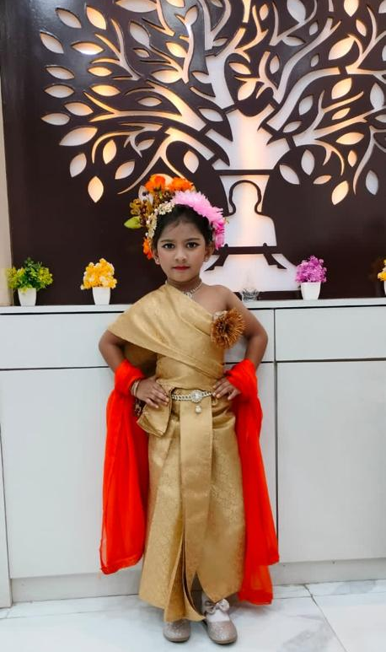
SPECTRUM 2.0
ALLENHOUSE PUBLIC SCHOOL, GHAZIABAD
THURSDAY & FRIDAY, 18th – 19th OCTOBER 2023

Slide 26
Winning Amidst Unknowns
CH.CHHABIL DASS PUBLIC SCHOOL, GHAZIABAD
MONDAY & TUESDAY, 30th – 31st OCTOBER 2023
COMPETITION | PARTICIPANT | CLASS / SECTION | NO. OF PARTICIPATING SCHOOLS | POSITION
CLAY MODELLING | AVNI AGGARWAL INNAYA KHATTAR | I B I F | 29 | I

Slide 27
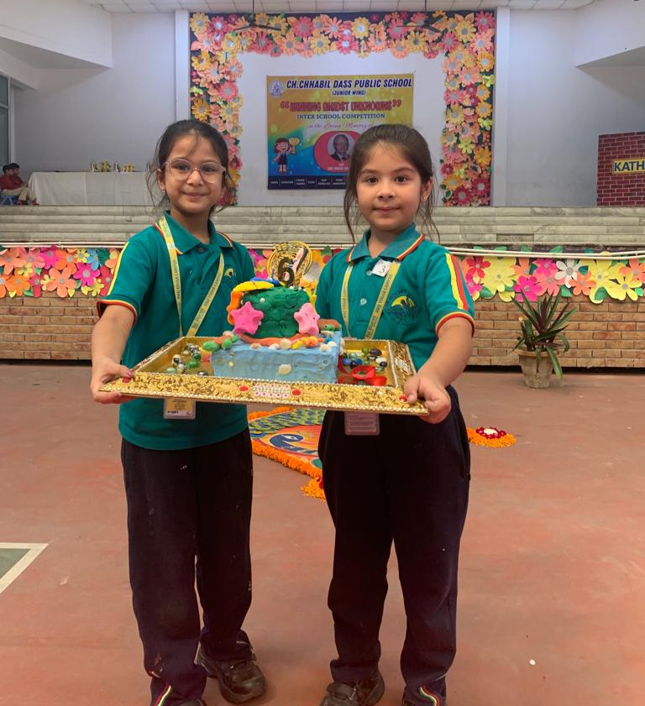
Winning Amidst Unknowns
CH.CHHABIL DASS PUBLIC SCHOOL, GHAZIABAD
MONDAY & TUESDAY, 30th – 31st OCTOBER 2023

Slide 28
Winning Amidst Unknowns
CH.CHHABIL DASS PUBLIC SCHOOL, GHAZIABAD
MONDAY & TUESDAY, 30th – 31st OCTOBER 2023
COMPETITION | PARTICIPANT | CLASS / SECTION | NO. OF PARTICIPATING SCHOOLS | POSITION
HINDI STORY NARRRATION (with the help of finger or hand puppets) | ATHARV NATANI KUNJIKA JAIN VRISHKA BANSAL | PRE SCHOOL C PRE SCHOOL C PRE SCHOOL C | 29 | II

Slide 29
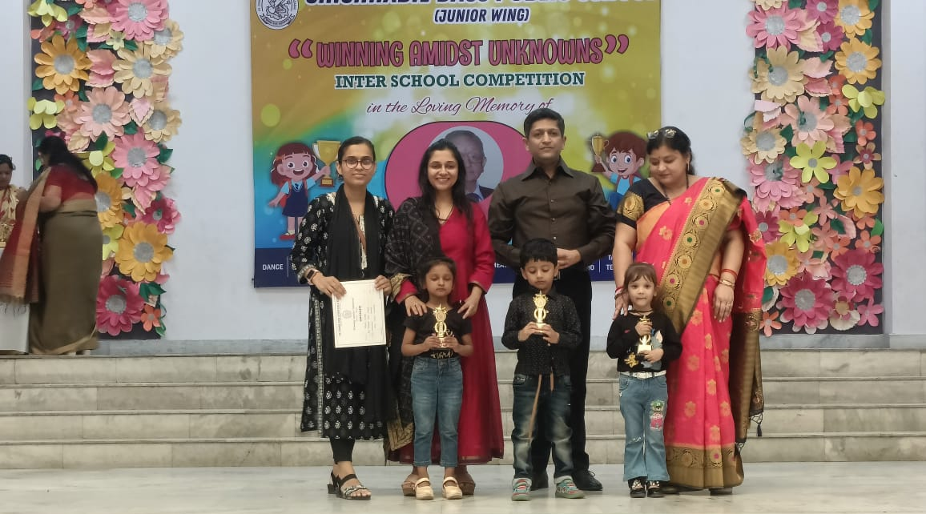
Winning Amidst Unknowns
CH.CHHABIL DASS PUBLIC SCHOOL, GHAZIABAD
MONDAY & TUESDAY, 30th – 31st OCTOBER 2023

Slide 30
Winning Amidst Unknowns
CH.CHHABIL DASS PUBLIC SCHOOL, GHAZIABAD
MONDAY & TUESDAY, 30th – 31st OCTOBER 2023
COMPETITION | PARTICIPANT | CLASS / SECTION | NO. OF PARTICIPATING SCHOOLS | POSITION
FOLK DANCE | PRAHI JAIN PRAVAR JAIN YASHIKA KUMARI VANYA GOEL SHARAV GOYAL JANHVI JAIN JAYANSH MEHNDIRATTA SHREEYANSH KUMAR | PRE PRIMARY A PRE PRIMARY B PRE PRIMARY D PRE PRIMARY D PRE PRIMARY F PRE PRIMARY G PRE PRIMARY G | 29 | III

Slide 31
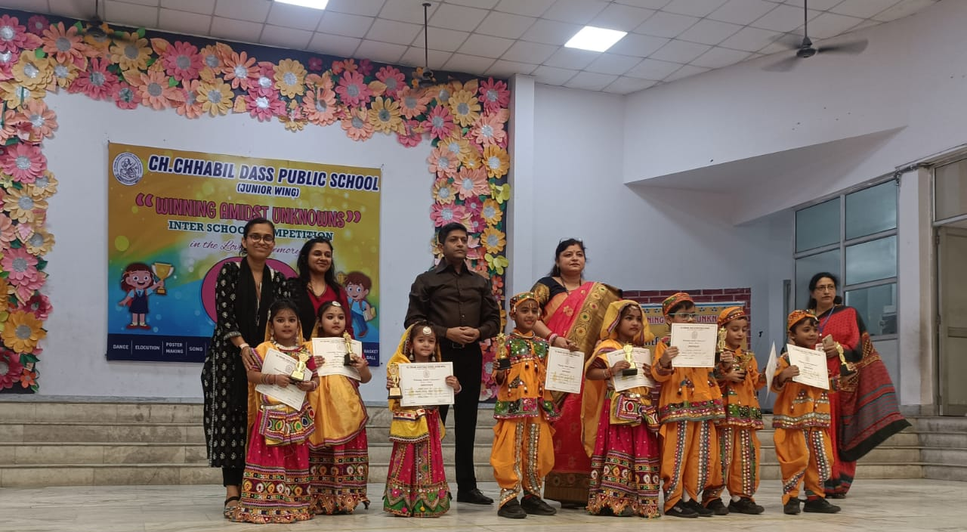
Winning Amidst Unknowns
CH.CHHABIL DASS PUBLIC SCHOOL, GHAZIABAD
MONDAY & TUESDAY, 30th – 31st OCTOBER 2023

